Slide 1
Software Engineering
LECTURE 1: Introduction

Slide 2

Introducing

Slide 3

Introducing

Slide 4
Course Information
Course Name: Software Engineering
Credit: 3
Lecture Day & Time:
    Wednesday (12:30 – 14:25) - Sec A
    Thursday (09:00 – 09:55 & 11:30-12:25) – Sec B
Textbooks :
    Software Engineering- a practitioner’s Approach BY Roger S. Pressman
    Software Engineering BY Ian Sommerville
Other Reading Materials: Research articles and (other) book chapter

Slide 5
What the class will look like
Lectures
Readings (articles and book chapters)
Class Tests
Term Paper/ Presentations/ seminars
Practical case study
Lecture Sessions will be Interactive !
Device-free – for your own sake!

Slide 6
Communication
Everything of this course will be handled by
Facebook !
  A closed and secret group will be created soon.
  All kind of course material will be delivered.
  Any kind of instruction, notice, CT results will be published.
  Any query related to this course will be placed there!
For any personal issue:
  E-mail to: nazrulturku@gmail.com
  Subject: Course no: Query
  Visit my room at 8th Floor

Slide 7
Quotation
To the , the glass is half full.
To the , the glass is half empty.
To the , the glass is twice as big as it needs to be.
Optimist
Pessimist
Engineer

Slide 8
Course Objective
You will gain a broad understanding of the discipline of software engineering and its application to the development of and management of software systems.
This includes:
knowledge of basic SW engineering methods and practices, and their appropriate application;
A general understanding of software process models such as the waterfall and evolutionary models.
An understanding of software requirements and the SRS document.
An understanding of different software architectural styles.

Slide 9
Course Objective
This includes (Continuing…)
An understanding of approaches to verification and validation including static analysis, and reviews.
An understanding of software testing approaches such as unit testing and integration testing.
An understanding on quality control and how to ensure good quality software.
An understanding of some ethical and professional issues that are important for software engineers.

Slide 10
Course Outline (Beta)
Introduction to software engineering
Software processes
Agile software development
Requirements engineering
System modeling
Performing user interface design

Slide 11
Course Outline (Beta)
Architectural design
Design and implementation
Product metrics
Software testing and maintenance
Security engineering
Project planning and management

Slide 12
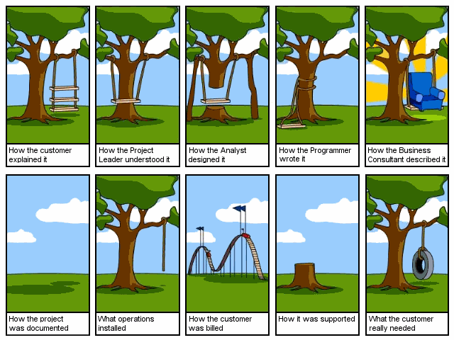
SW Engineering!

Slide 13

SW Engineering!

